Slide 1

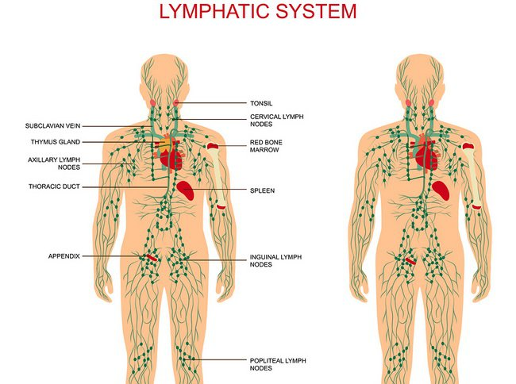
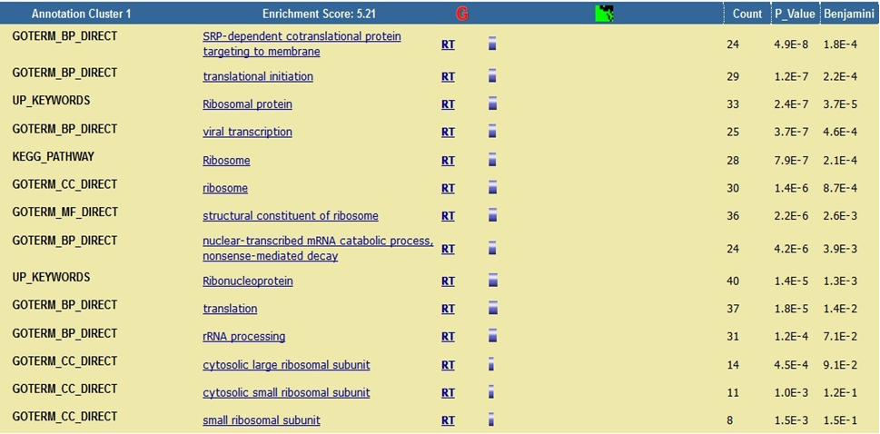
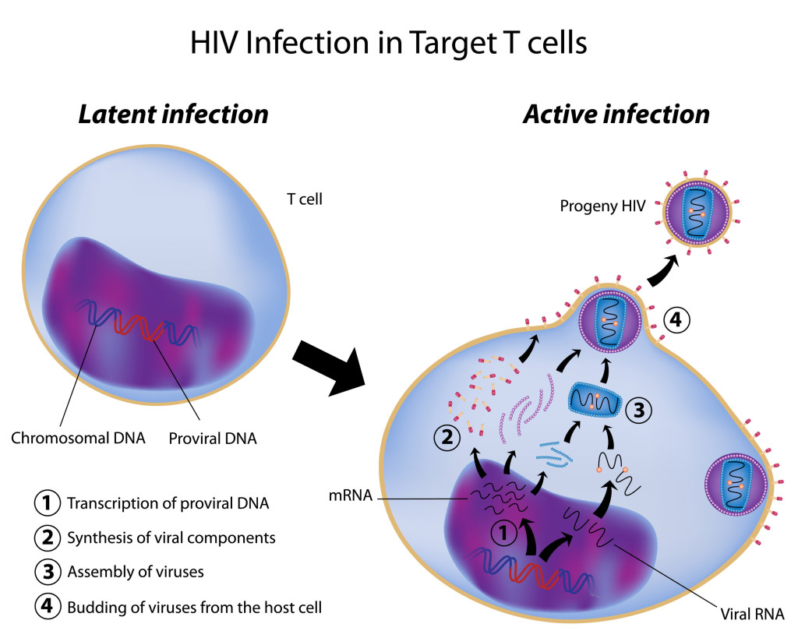
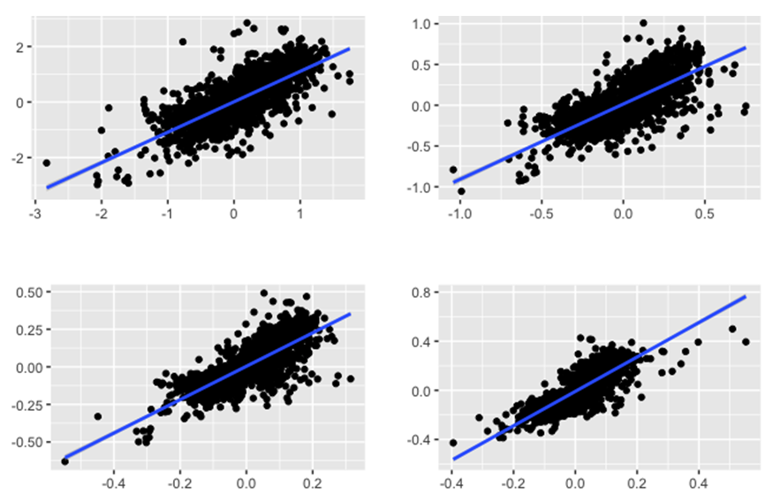
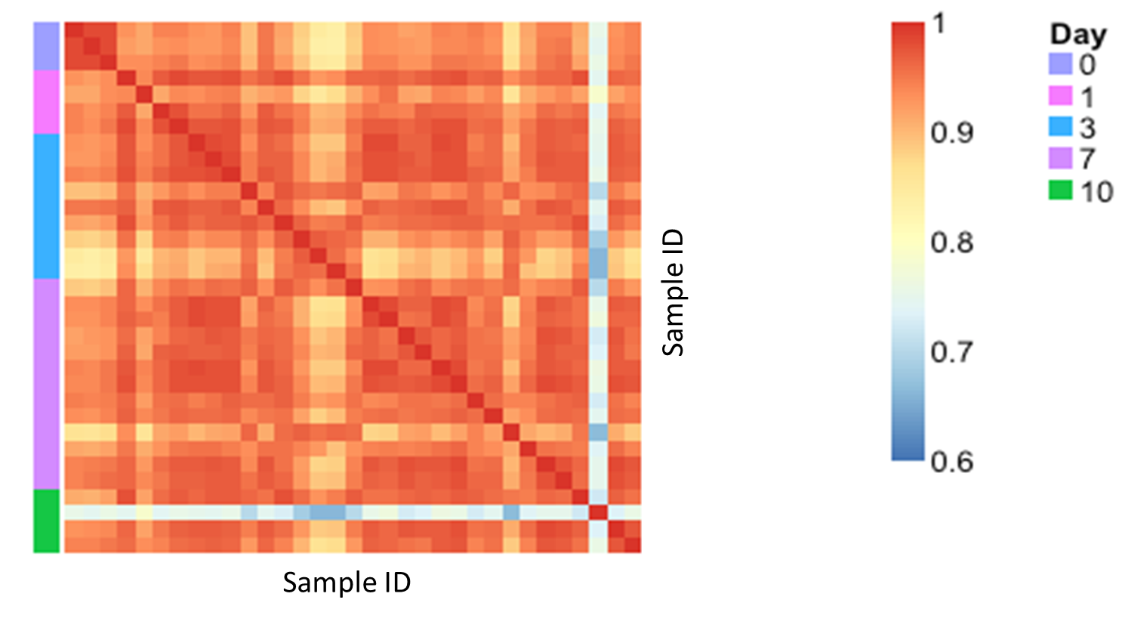
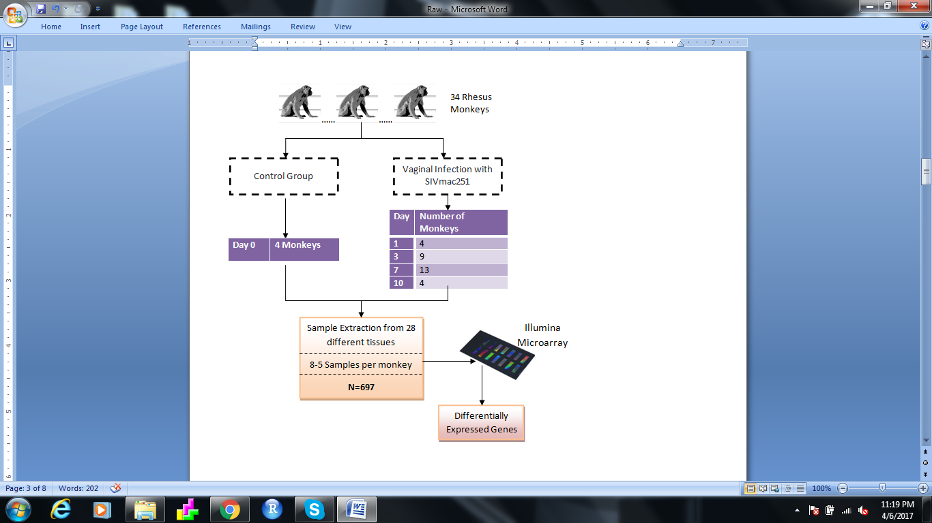
Evaluating Tissue-Specific and Temporal Gene Expression Changes after Simian Immunodeficiency Virus (SIV) Infection in Rhesus Monkeys
Christina Michalski, Heather A. MacKay, Jeffrey Tang, Nichalle Brito, Rebecca Asiimwe
INTRODUCTION
Methods
Gene analysis
Human immunodeficiency virus (HIV) has continued to be a public health issue on a global scale and 35 million people have died due to the onset of acquired immunodeficiency syndrome (AIDS)-related diseases (1).
Early diagnosis is crucial as it enables the control of infection via antiretroviral therapy in addition to reducing the risk of transmission (2). It is estimated that half of the patients with HIV worldwide are “late-presenters” due to the asymptomatic nature of the virus (3); a rationale for which more knowledge is needed to understand the early stages of HIV infection, and immune response.
Preliminary Data Inspection
Imported the Data
How does gene expression change in tissues post-SIV infection?
Fitted a variety of tissue-specific linear models with different parameters
Are there correlations between changes in blood transcriptomic profiles to tissues?
Packages used for this analysis: ggplot2, limma, VennDiagram , gridExtra, and dplyr
Cleaned the data/subset relevant tissues for analysis
Identified outliers via. Tissue and sample specific correlation analysis
Normalized the data via quantile normalization
Packages used for this analysis: GEOquery, Biobase, NMF, preprocessCore, and ggplot2
How does gene expression within the lymph node tissues differ?
Fitted contrast matrices and linear models between lymph tissues
Conducted hierarchical clustering and PCA analysis
Packages used for this analysis: limma, dplyr, ggplot2, stringr, stringi, NMF, and PCA3d
Used the tissue-specific linear models fit for question 1 and compared the number of overlapping differentially expressed genes between tissues
Conducted gene enrichment analysis to identify the genes and biochemical pathways that are significantly altered with SIV infection via. Entrez annotation, DAVID gene enrichment and KEGG pathway analysis
Packages used for this analysis: limma, dplyr, lattice, gridExtra, ggplot2, and illuminaHumanv4.db
Identified the best models for the data by AIC comparison between models with different parameters (e.g. with and without a quadratic of time)
Compared the logFC of overlapping differentially expressed genes between tissues
Functional annotation clustering based on enrichment score using DAVID revealed that these differentially expressed genes were most enriched for ribosomal related functions.
This was not far from expected due to the nature of the retrovirus as it requires host cell machinery for viral replication.
Figure 3: The top annotation cluster of differentially expressed probes in the Mesenteric Lymph Node [DAVID and KEGG pathway analysis].
Simian immunodeficiency virus (SIV), a retrovirus infecting nonhuman primates, has similar symptoms and viral life cycle to that of HIV (1,4). Phylogenetic analysis shows that SIV and HIV are ancestrally related and are closely related in viral replication and propagation, making it a good model to understand early development of infection. This project aimed at evaluating tissue-specific transcriptomic changes in the first ten days after vaginal SIV infection in rhesus monkeys.
Comparison of transcriptomic changes between tissues
To assess whether transcriptomic changes are the same in blood and other tissues, we first calculated the overlap between DE probes in each tissue and blood (Fig. 4A). For the “common DE probes”, we fitted four linear models for each tissue comparing each day to day 0. The resulting fold changes for each probe were compared between tissues (Fig. 4B).
A)
B)
Day 1
Day 3
Hypothesis
Results
logFC Jejunum
Temporal tissue-specific transcriptomic changes occur after SIV infection in Rhesus Monkeys.
Data cleaning
Day 7
Day 10
C)
Objectives
Prior to analysis, raw data was cleaned and normalized. Tissues with at least 3 biological replicates for each time point were selected, reducing sample size to 231. Presence of outliers was assessed by examining inter-sample correlation within each tissue. Outliers were found in the colon and tonsils samples, leaving 228 samples for final analysis. PreprocessCore was used to log2 normalize the cleaned dataset.
 | Intercept | Slope | Adj. R^2
Day 1 vs. 0 | 0.009 | 1.10 | 0.57
Day 3 vs. 0 | 0.0151 | 0.92 | 0.55
Day 7 vs. 0 | 0.0039 | 1.11 | 0.63
Day 10 vs. 0 | -0.0085 | 1.40 | 0.68
Analyze how gene expression changes in various tissues after SIV infection
Assess whether transcriptomic changes in blood are the same as in other tissues.
Investigate whether transcriptomic changes in lymph nodes vary by lymph node location.
logFC Blood
Study Design
Figure 4: Comparison of DE probes in blood and jejunum. A) Overlap of DE probes. B) Correlation between fold changes of common DE probes. C) Regression statistics from the correlation between fold changes shown in B.
The data used in this study was published in Cell by Barouch et al. in April 2016 (5). The corresponding dataset is publicly available on Gene Expression Omnibus under the accession number GSE80013.
Tissues were collected at different time points post infection and analyzed by Illumina HumanHT-12 V4.0 expression BeadChip array. For each sample, 47,232 probes corresponding to over 30,000 genes were quantified.
In the publication, the tissue samples were grouped into four categories (blood, female reproductive tract, gastrointestinal tract and lymph nodes) and analysis was performed for these four categories.
PCA
Unsupervised clustering was performed on the lymph node samples to assess whether they would cluster by location. Samples taken from day 0 (control group) clustered separately from the other time points whereas lymph node location did not influence cluster formation. PCA yielded similar results, indicating no effect of distance from infection site on transcriptomic changes.
Figure 1: Inter-sample correlation before cleanup of colon samples.
Linear Model Fitting and Validation
A)
B)
Two linear models for each of the seven tissues were fit to identify differentially expressed genes with respect to time. We compared a linear model with and without a quadratic of time to capture non-linear expression trends. To determine the model that best fits the data we compared the AIC values. For most probes, there is no advantage of one model over the other as indicated by a small difference in AIC values. However, there are several probes for which the quadratic model is significantly better (Fig. 2). We therefore chose the quadratic model for all downstream analysis.
Table 1: The number of differentially expressed genes for each tissue using the quadratic models.
Percent of total
Figure 5: PCA of the lymph node samples. Annotated by time point (A) or lymph tissue type (B).
Tissue | Number of hits at FDR <= 0.05
Jejunum | 5463
Blood | 4103
Tonsil | 316
Auxiliary Lymph Node | 2561
Mesenteric Lymph Node | 2063
Genital Pelvic Lymph Node | 1886
Colon | 595
Conclusion
In line with the findings from Barouch et al. we find that significant transcriptomic changes occur as early as day 1 post infection throughout host tissues. This knowledge is crucial for development of treatment as well as vaccines and more effective post-exposure prophylaxis drugs.
References
AIC_{linear} – AIC_{quadratic}
Stevens, D.R. et al. (2017). A Global Review of HIV Self-testing: Themes and Implications. AIDS Behavior. doi:10.1007/s10461-017-1707-8.
Mocroft, A. et al. (2013). Risk factors and outcomes for late presentation for HIV-positive persons in Europe: results from the Collaboration of Observational HIV Epidemiological Research Europe Study (COHERE). PLoS Med 10: e1001510.
Levy, I. et al (2016). Missed opportunities for earlier diagnosis of HIV in patients who presented with advanced HIV disease: a retrospective cohort study BMJ 6: e012721.
Klatt, N.R., et al. (2012).Nonpathogenic Simian Immunodeficiency Virus Infections. Cold Spring Harbor Perspectives in Medicine 2: a007153.
Barouch, D.H. et al. (2016). Rapid Inflammasome Activation Following Mucosal SIV infection of Rhesus Monkeys. Cell 165: 656-667.
Figure 2: Histogram of the difference in AIC values between the linear and the quadratic model for the jejunum.

